Slide 1
ARACNE MODEL

Slide 2

ARACNE
Integrated model for:
Professional qualification
Empowerment
Group self-employment

Slide 3
1.
Introduction

Slide 4
ARACNE aims to develop students' skills, values and attitudes, training them and encouraging an entrepreneurial attitude - especially within the social economy

Slide 5
Analysis of good practices
Situations that most affect groups
Impact and strategies regarding getting into work and best practices on:
  Training
  Empowerment
  Self-employment
Methodology lessons and aspects for improvement

Slide 6
Integrated job placement pathway
Empowerment of female students in regard to decision making within their careers

Slide 7
2.
The ARACNE model
Training, Empowerment, Entrepreneurship

Slide 8
Situations that it aims to change
Precarious professional cycle
Social and personal poverty
Undeveloped professional skills
Getting into debt
Competencies with no outlet
Dependence on family/govt./etc
Unemployment
Underemployment
Difficulties in relationships
Stand-by competencies
Serious health problems
Precarious employment

Slide 9
TRIPLE CHALLENGE
1. Access to professional function; lifelong learning
2. Progressive empowerment
3. Group self-employment opportunities

Slide 10

The basic unit for service is the training activity
All services should be designed in accordance with a series of methodological criteria
Develops three specific training pathways and one integrated pathway
Has a predefined competencies map in regard to learning
Has designed a set of training activities - not complete - which covers the previously predefined competencies
Simultaneously develops professional training, empowerment and group self-employment
Incorporates three levels of progressive learning
1
The 7 characteristics of the ARACNE model
6
7
5
3
4
2

Slide 11
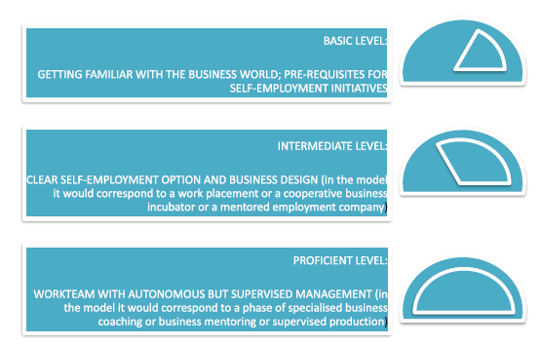
3 levels of learning

Slide 12

Any service should combine the development of competencies at each learning level

Slide 13
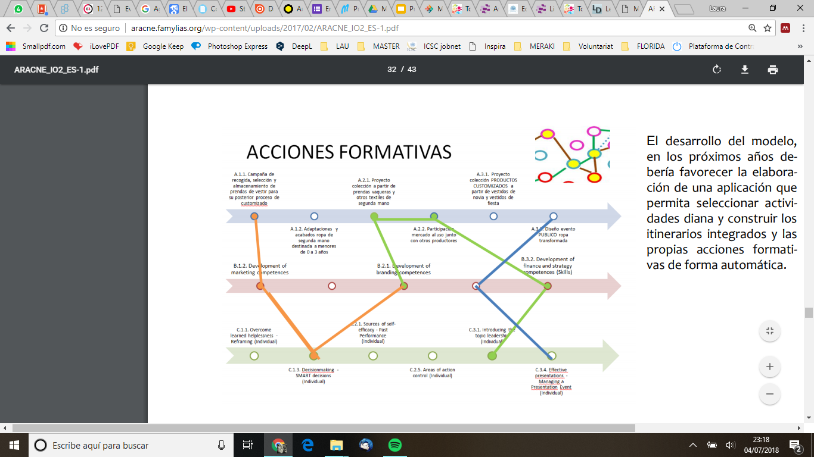
Map of the model
Training activity
Levels 2-3
Learning level 1
Learning level 2
Learning level 3
Professional function
Activity
Self-employment
Empowerment
Integrated pathway Levels 1-3

Slide 14

Road map
Train the Trainers
ARACNE+ Training (C1)
Train the Trainers ARACNE
Test model ARACNE+ (O2)
Pilot test: end users
Given by: ARACNE trainers

Slide 15

Applying the model
Initial student evaluation
Adapted competencies map
Evaluation criteria
Training activities
Evaluation of progress and impact

Slide 16

Thank you!
Any questions?

Slide 17
Credits
Presentation template by SlidesCarnival
Photographs by Unsplash
Watercolour textures by GraphicBurguer

