Slide 1
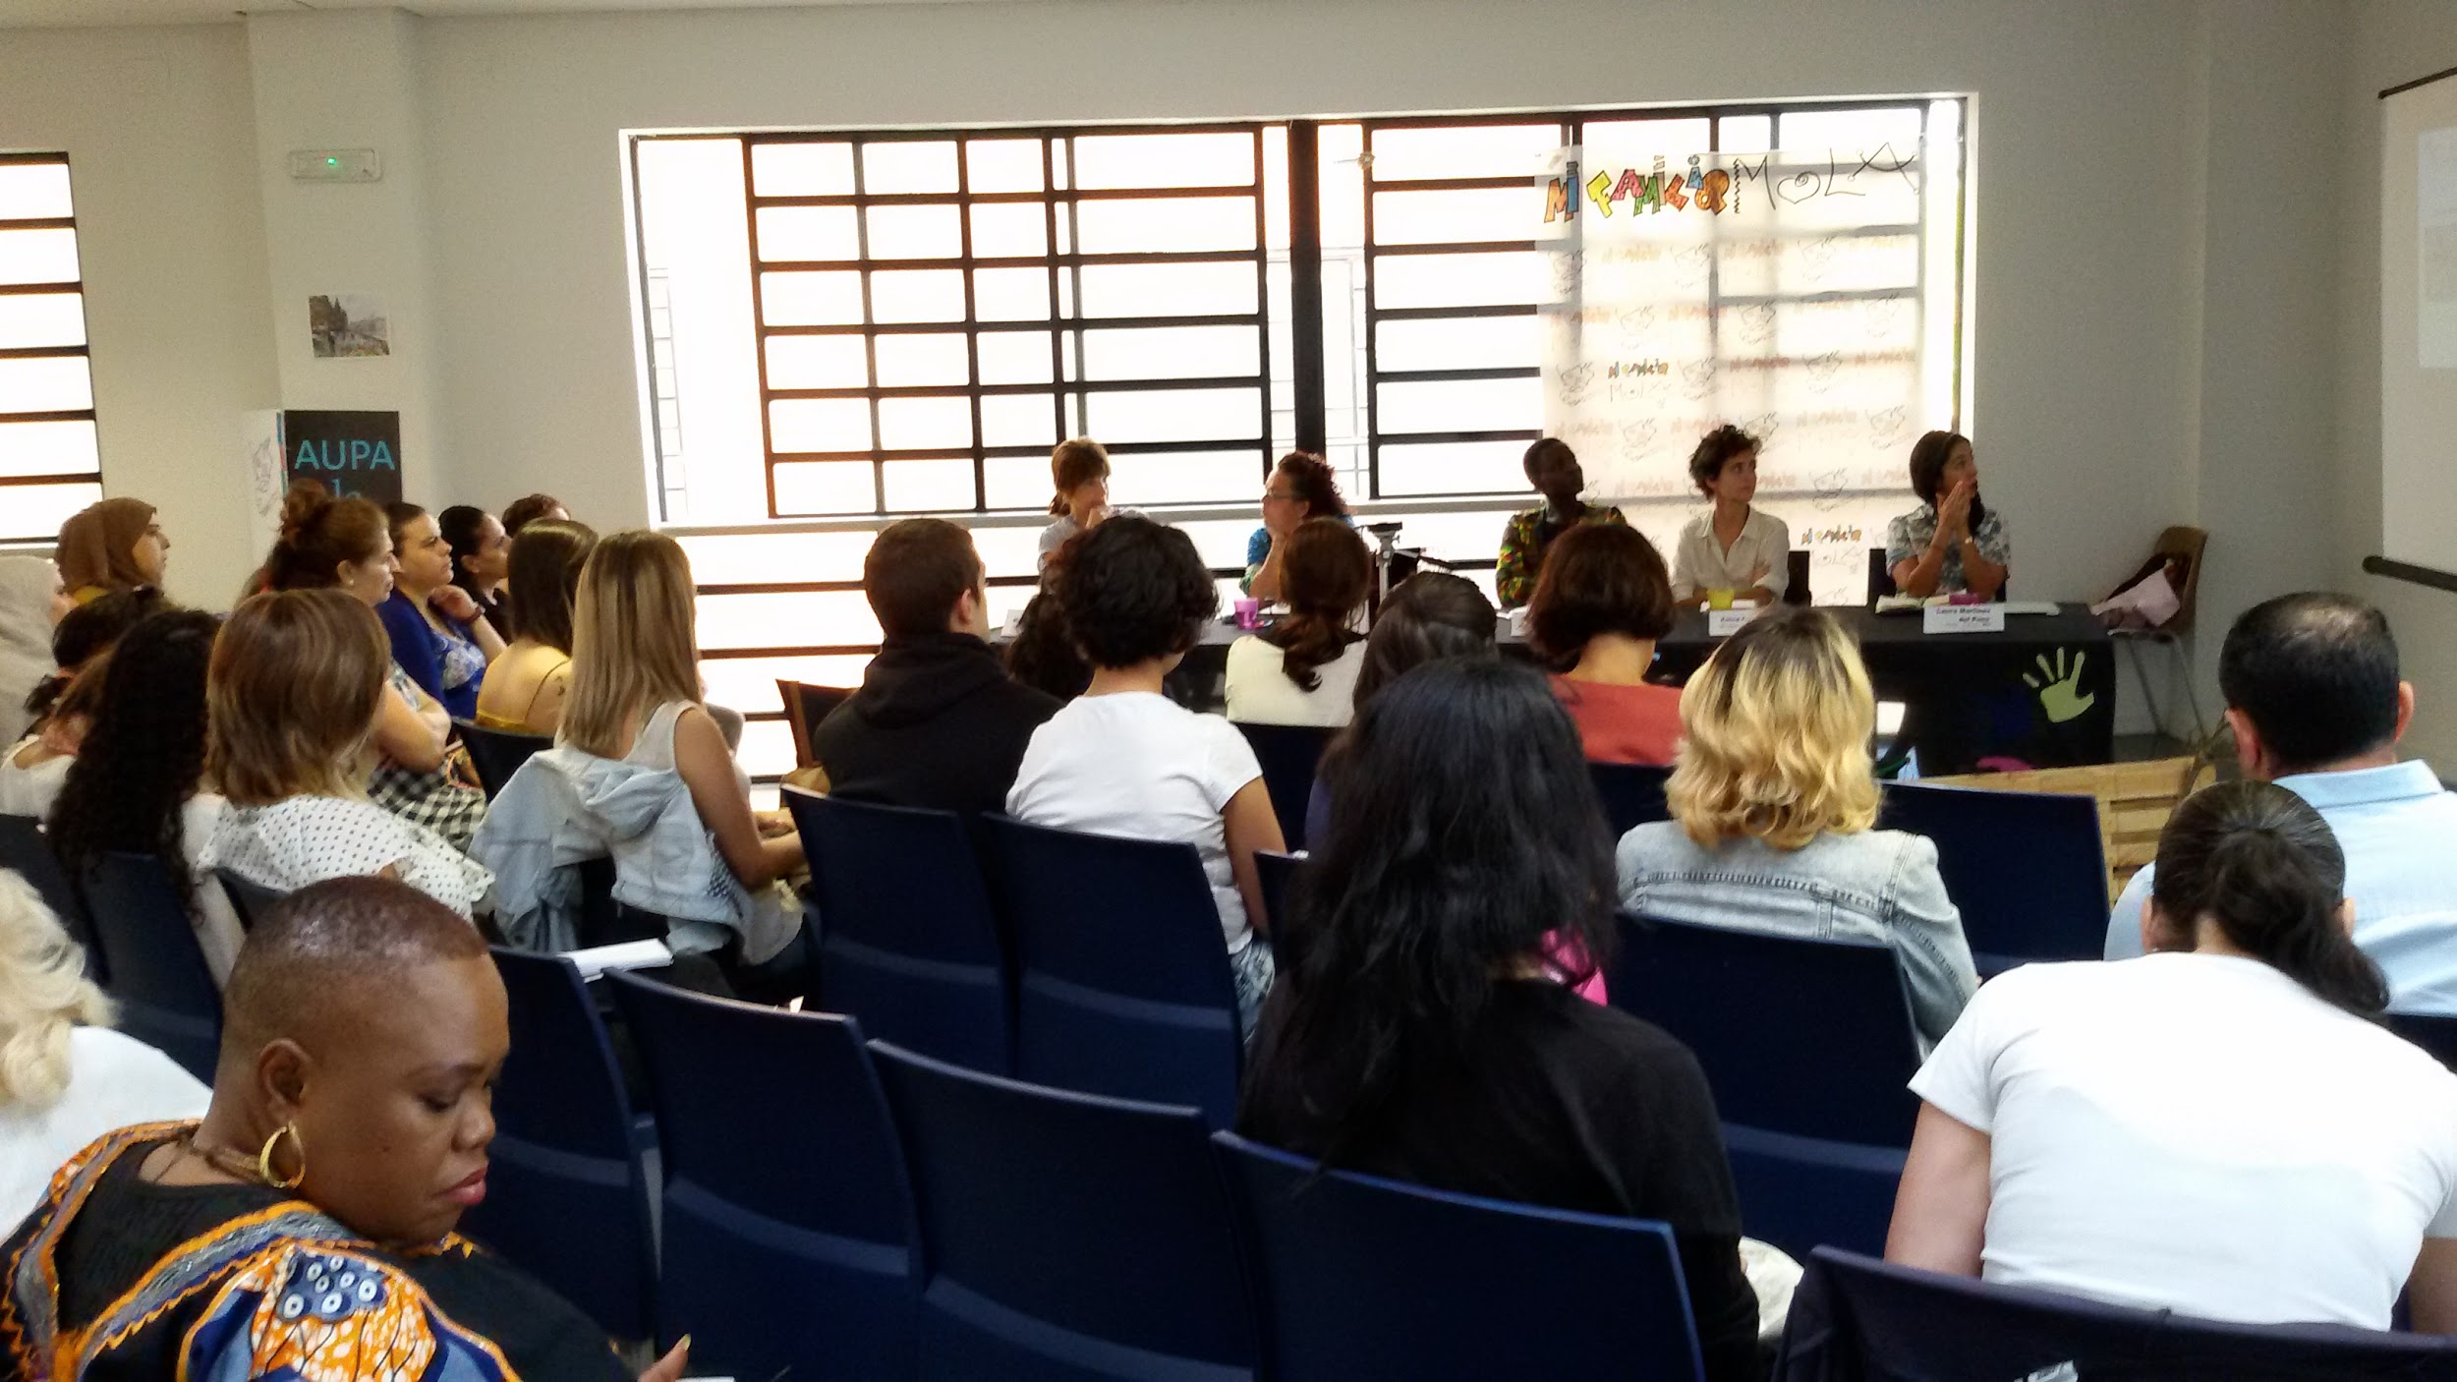
ADULT PROFESSIONAL DEVELOPMENT.
ARACNE MODEL

Slide 2
1.
CONCEPT
Permanent learning competencies to help overcome insecure conditions of unskilled jobs

Slide 3
Seven characteristics:
Simultaneously develops vocational training, empowerment and group self-employment.
Incorporates three levels of progressive learning.
Has a predefined competencies map in regard to learning.
Has designed a set of training activities (not complete) which covers the previously predefined competencies.
Develops three specific training pathways and one integrated pathway.
The basic service unit is the training activity.
All social services should be designed in accordance with a series of methodological criteria.

Slide 4
Professional function
This is the role that is played, recognised and accepted by society for members of a particular discipline.
It is evidenced through the activities or tasks involved in carrying out a profession.

Slide 5
a. Official qualification
Professional function
b. Encourages specialisation in a particular professional field
c. Tends to be developed in a real production environment
d. Meaningful learning (adults)

Slide 6



Professional function
Occupational
Medium level
Certificates of professional competence
BASIC LEVEL:
Required quality of completion, under the SUPERVISION OF A MANAGER
ADVANCED LEVEL:
ORGANISATION OF WORK, application of required techniques and procedures, and achieving the required quality of completion
INTERMEDIATE LEVEL:
APPLICATION OF REQUIRED TECHNIQUES AND PROCEDURES and required quality of completion
Highest level

Slide 7
As an example, professional function will vary according to the job that one wishes to do:
Basic
VOCATIONAL TRAINING
Intermediate VOCATIONAL TRAINING
Advanced VOCATIONAL TRAINING
ENVIRONMENTAL EDUCATION
• Interpreting the reciprocal influence between human activities and the social and natural environment (UC0805_3)
PORTFOLIO OF SUPPLIERS
• Establish a Portfolio of Suppliers of second-hand clothing that can be customised
ORGANISING THE WORKSPACE
• Prepare materials, tools, machinery and sewing equipment. (UC1225_1)
CREATIVE SEWING
• Adapting and tailoring garments. (UC1227_1)
ENVIRONMENTAL EDUCATION
• Interpreting the reciprocal influence between human activities and the social and natural environment (UC0805_3)
CREATIVE SEWING
• Transform textile and non-textile materials for use in garments that have been altered or other textile garments (UC1521_3 ADAPTED)
Hand cutting and assembly (UC1234_2) and machine assembly. (UC1235_2)
CUSTOMER SERVICE
• Attending to customers in regard to garment tailoring services. UC1237_2:
• Displaying products on public market stalls
ENVIRONMENTAL EDUCATION
• Interpreting the reciprocal influence between human activities and the social and natural environment (UC0805_3)
CREATIVE SEWING
• Developing prototypes. New models
• Analysing and interpreting the design, working together to define the product using fabric and leather. UC0912_3
• Planning and developing patterns for garments that are to be made UC0914_3
Making model designs, pattern designs and cutting clothing or other textile garments UC1519_3
See a more developed version of the competencies map: https://drive.google.com/file/d/0B0nq-A7HBqO1d1pQT0R2enpoZWM/view?usp=sharing

Slide 8
Group self-employment
This means dealing with the individual commitment to entrepreneurship, enabling work teams with complementary skills, that go beyond a simple sum of knowledge.
The model must enable management of the company itself.

Slide 9
a. Generates a scenario that enables their professional development
Group self-employment
b. Mentoring for progressive learning
c. Capitalisation
d. Their level of development depends on the surrounding entrepreneurial culture

Slide 10
Group self-employment
Awareness raising
Formative business practice
UPPER LEVEL:
WORK TEAM WITH AUTONOMOUS BUT SUPERVISED MANAGEMENT (under the model, relates to a phase for specialist business coaching or business mentoring or supervised production)
INTERMEDIATE LEVEL
CLEAR OPTION FOR SELF-EMPLOYMENT AND DESIGN OF COMPANY (would apply within the model with a phase of training placements or cooperative company incubator or supervised job placement company)
BASIC LEVEL
APPROACH TO THE COMPANY AND PREREQUISITES UNDER SELF-EMPLOYMENT INITIATIVES
Formative business practice

Slide 11
Group SELF-EMPLOYMENT, a set of pre-selected competencies for each learning level
Basic
SELF-EMPLOYMENT
Intermediate
SELF-EMPLOYMENT
Advanced
SELF-EMPLOYMENT
SELF-EMPLOYMENT INITIATION
Analysis of employment
Myths and barriers to self-employment
Women and self-employment (socio-cultural and economic influence)
Advantages and disadvantages of self-employment
Entrepreneur versus wage earner
Self-employment formulas
Social economy and group self-employment
How to set up a company
Developing productive/innovative ideas (Design Thinking methodology)
Access to grants and financing formulas for self-employment initiatives
PLANNING
Writing a business plan (determining the activities to be undertaken, identifying sources of business, marketing strategy, financial plan, organising cooperative business activities).
MANAGING AND CONTROLLING DAILY ACTIVITY
Learning techniques and procedures for managing suppliers and logistics.
Identifying production processes
Support and interoperation networks, developing partnerships
ADMINISTRATIVE MANAGEMENT:
Understanding, procedures and techniques relating to legal, tax and administrative issues in order to start a business.
Access to financial resources
Controlling finance and accounting flow
SELLING AND MARKETING PRODUCTS AND SERVICES
Defining and putting into practice processes, protocols and techniques for product and service promotion, distribution, sales and after-sales service
PLANNING
Establishing a control system (objectives, evaluation indicators, process managers) for production, management, marketing, partner management, internal organisation)
MANAGING AND CONTROLLING DAILY ACTIVITY
Advanced supplier management system and advanced logistics, production processes, labour management, quality control systems (environmental, social and economic)
Partner management
ADMINISTRATIVE MANAGEMENT:
Dashboard management: Acquiring tools to manage economic, financial, regulatory, internal administration, logistics and production flows.
SELLING AND MARKETING PRODUCTS AND SERVICES
Advanced marketing mix management procedures
WORKPLACE HEALTH & SAFETY
Security obligations and management
See a more developed version of the competencies map (with tabs at the bottom for accessing the different areas) at https://drive.google.com/file/d/0B0nq-A7HBqO1d1pQT0R2enpoZWM/view?usp

Slide 12
Individual and group empowerment
  This is the process through which an individual, community or social group is given a set of tools to increase its strength, improve its capabilities and increase its potential - all with the aim of improving its social, political, financial, psychological or spiritual situation.
  The ultimate goal of social empowerment is that the group is itself capable of working and organising to improve their living conditions.
.

Slide 13
a. Generates permanent changes
Individual and group empowerment
b. Engages with the environment
c. Provides resources for life
d. Is based on the principle of citizenship

Slide 14
Individual and group empowerment
Self-assertion
Professional decision making
ADVANCED LEVEL
Mobilising to identify their interests and transform relationships, structures and institutions that hold them back and perpetuate their subordinate position (‘power for’)
INTERMEDIATE LEVEL
  Autonomous organisation to decide on their lives and on how they want to develop (‘power with’)
.
BASIC LEVEL
Awareness of their subordinate position and increase in self-confidence (‘self power’)
Transformation

Slide 15
Individual and group empowerment
Self-assertion
Professional decision making
ADVANCED LEVEL
INDIVIDUAL: The participant is able to teach others. They have confidence in their potential, and awareness of gender inequality
AT GROUP LEVEL: Cooperative functioning, high level of commitment to each other, succeed as groups, increase visibility and public image of the group and its ideas
BASIC LEVEL
INDIVIDUAL: The participant is aware of their personal and professional potential and limitations
AT GROUP LEVEL: Participants agree to be part of the group
INTERMEDIATE LEVEL
INDIVIDUAL: The participant is capable of empowering him/herself.
AT GROUP LEVEL: Participants work together on common objectives
Transformation

Slide 16
As part of EMPOWERMENT, we carried out a provisional classification - the result of group reflection that is liable to variation in future revisions of the model.
Basic EMPOWERMENT
SELF-ASSERTION:
Self-confidence
Self-control
overcoming learned helplessness,
ask for help
communicate feelings.
relation
collaboration
RAISING AWARENESS
Ability to analyse objectively, with empathy
Raising awareness of discrimination
development of social skills within the group
Intermediate EMPOWERMENT
SELF-ASSERTION
communication
professional development project,
accessing and managing resources,
group awareness,
expression of involvement and emotions
Compliance with rules and tasks
Team working
RAISING AWARENESS
critical political awareness
flexibility
DECISION ON THEIR LIVES AND DEVELOPMENT
Initiative and decision-making,
Advanced EMPOWERMENT
SELF-ASSERTION
Emotionally involved in development
Public expression of one's own thoughts, ideas, beliefs
Search for synergies
Boosting others' capabilities
Visibility as a group
RAISING AWARENESS
Reflective thinking
DECISION ON THEIR LIVES AND DEVELOPMENT
Leadership (females)
Worker-entrepreneur bipolarity
Organisational capacity
Ability for dialogue
TRANSFORM THE ENVIRONMENT/STRUCTURES
Ability to project
Managing change
Creativity
negotiation
Visibility
Representation within a group
Democratic management of working teams
See a more developed version of the competencies map (with tabs at the bottom for accessing the different areas) at https://drive.google.com/file/d/0B0nq-A7HBqO1d1pQT0R2enpoZWM/view?usp

Slide 17
CLASSIFICATION OF FUNCTION-BASED EMPOWERMENT COMPETENCIES
INDIVIDUAL:
Self-confidence
Self-control
Flexibility
Tolerance of frustration
Emotionally involved in development
Mathematical reasoning
Boosting others' capabilities
Capacity for analysis
Projection
PROFESSIONAL
Initiative and decision-making
Creativity
Planning
Organisation
Handling new technologies
Leadership
Negotiation
GROUP Communication
Compliance with rules and tasks
Ability to build relationships
Ability for dialogue
Social sensitivity
Critical consciousness
Public expression
Competencies
Empowerment
GROUP SELF-EMPLOYMENT
Team working
Search for synergies
Conflict resolution
Representation
Democratic management of teams

Slide 18
METHODOLOGICAL CRITERIA
ARACNE MODEL
Developing creativity
Learning in a production environment
Community resource network management
Entrepreneurial attitude
Visibility
Effective use of ICTs
Teaching staff
Self-guided learning
Basic skills
Professional diversification
Capitalisation
Applying ARACNE METHODOLOGICAL CRITERIA
This photo by an unknown author is under license CC BY-SA-NC

Slide 19
The specific nature of adult education
‘The expressive education of adults refers to the totality of the organised processes of education, whatever the content, level and method, whether formal or not, whether they prolong or replace the initial education provided in schools and universities, and in the form of professional learning, thanks to which, anyone considered to be an adult by the society to which they belong, develop their skills, enrich their knowledge, improve their technical or vocational skills or provide them with new guidance, and change their attitudes or behaviour in terms of the dual perspective of integrated enrichment of men and women and participation in balanced and independent socio-economic and cultural development.’

Slide 20
Adult education: differentiates them from education provided to young people
  1. Knowing why: The need to know why they need to learn something before embarking on a training process.
  2. Self-concept: The need to be treated as people with self-management capability.
  3. Learning from experience: The experiences are qualitatively and quantitatively different from those of teenagers and young people.
.

Slide 21
Adult education: differentiates them from education provided to young people
  4. Unlearning: Popular thinking must be contrasted with scientific knowledge of the facts.
  5. Transforming the experience: Transform popular understanding into new knowledge.
  6. Real-life situations: Better assimilation of knowledge, skills, values and attitudes when teaching is linked to real-life situations.
.

Slide 22
Adult education: differentiates them from education provided to young people
  7. Intrinsic motivation: The willingness to learn is related more to intrinsic reasons than to extrinsic ones.
  8. Learning orientation around a problem or a task. Unlike minors, for teenagers learning is oriented around a theme.
  9. They learn in complex situations and in relation to complex situations involving interaction and an interdisciplinary approach.
.

Slide 23
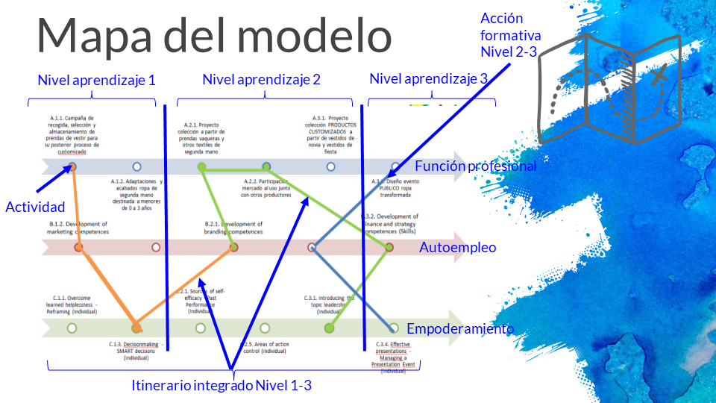


Slide 24
THANK YOU
.... comments, questions and clarification....

