Slide 1
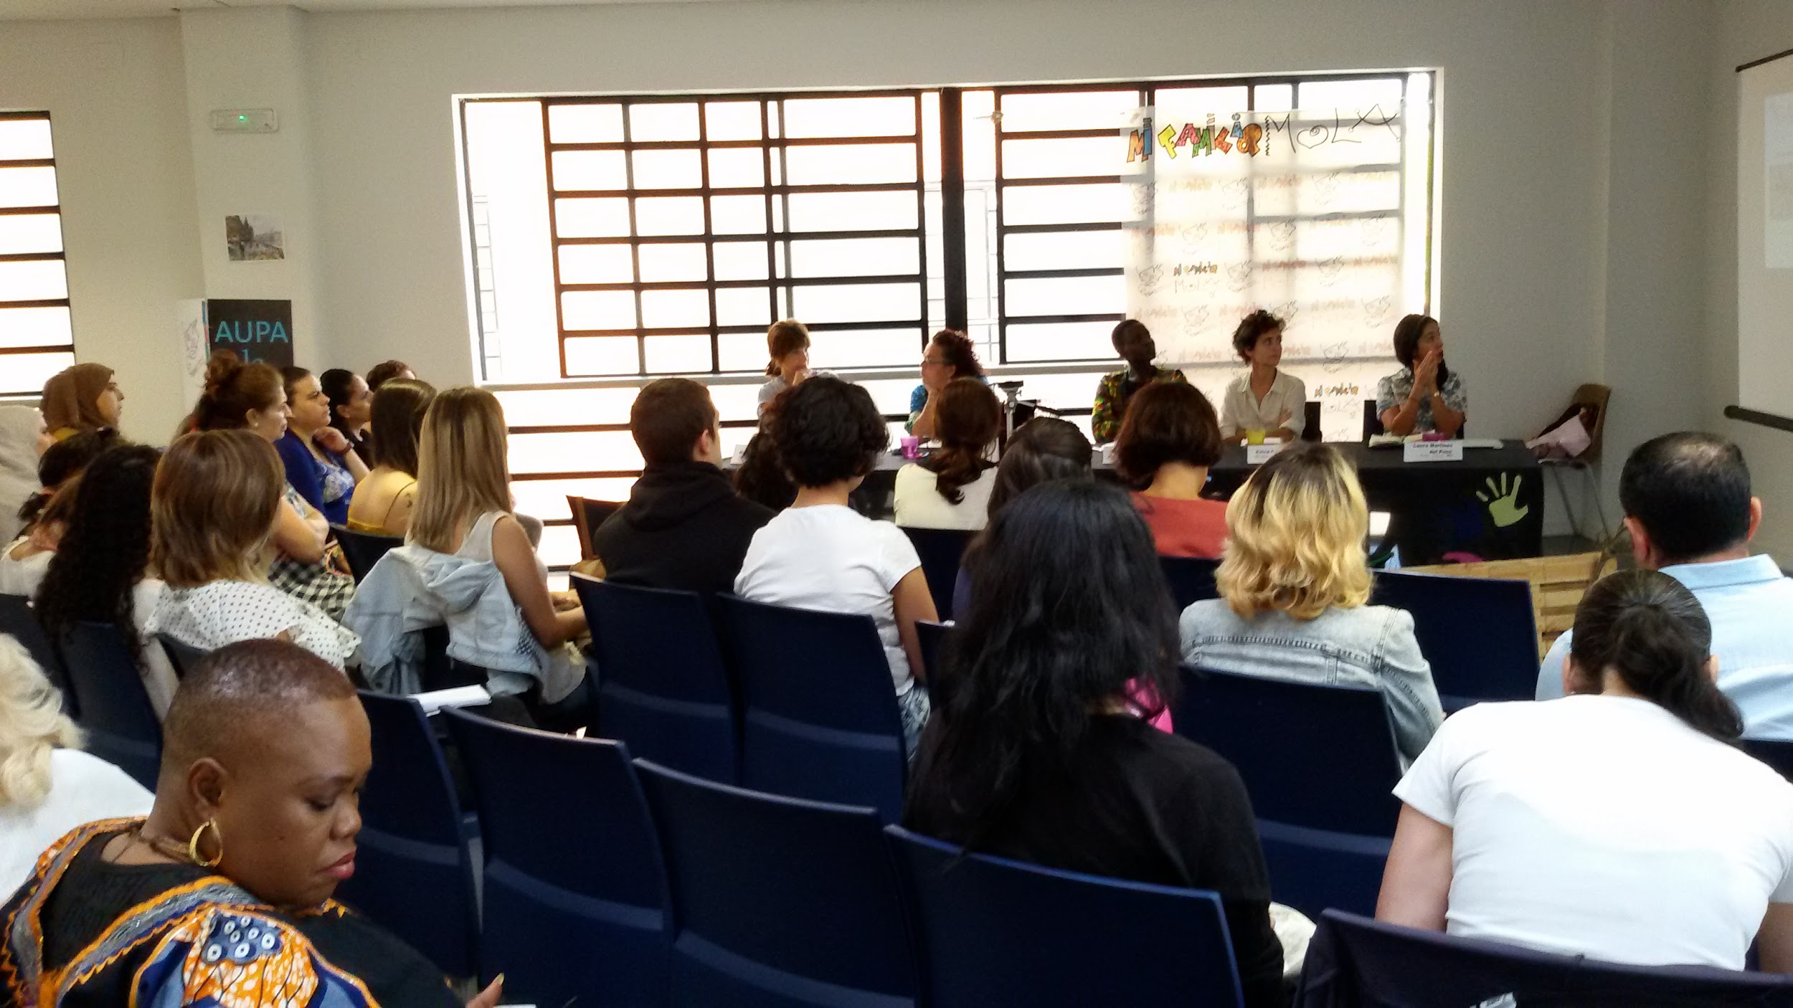
APPLICABILITY HYPOTHESIS
Aracne+

Slide 2
1.
Introduction

Slide 3
Introduction
Starting point: outline of training activity (basic unit of service)
Analyse the target group
  Empathy Map
  Johari Window
  Interviews...

Slide 4
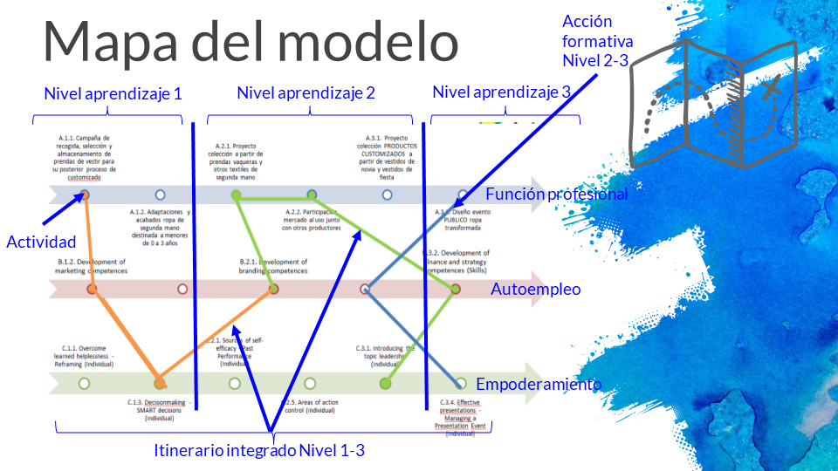

Slide 5
Integrated job placement pathway
Giving female students the skills to make decisions within their professional career

Slide 6
2.
Applicability hypothesis

Slide 7
Applicability hypothesis
contents (1)
Introduction and context in which the training will be delivered.
Common objectives between the training activity and specific context-related objectives.
General description of the three parallel activities.
Common and specific methodology requirements for each training activity.

Slide 8
Applicability hypothesis
contents (2)
Resources needed.
Partnerships with organisations and companies.
Indicators for assessing the extent to which the model applies to the proposed activities.

Slide 9
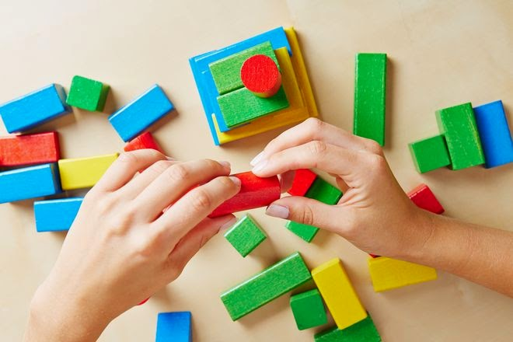
Applicability hypothesis
Let's get to work!
Put together a presentation with the contents that have been set out
This photo by an unknown author is under license CC BY-SA-NC

Slide 10
Applicability hypothesis
Introduction and context in which the training will be delivered.
Common objectives between the training activity and specific context-related objectives.
General description of the three parallel activities.
Common and specific methodology requirements for each training activity.
Resources needed.
Partnerships with organisations and companies.
Indicators for assessing the extent to which the model applies to the proposed activities.

Slide 11
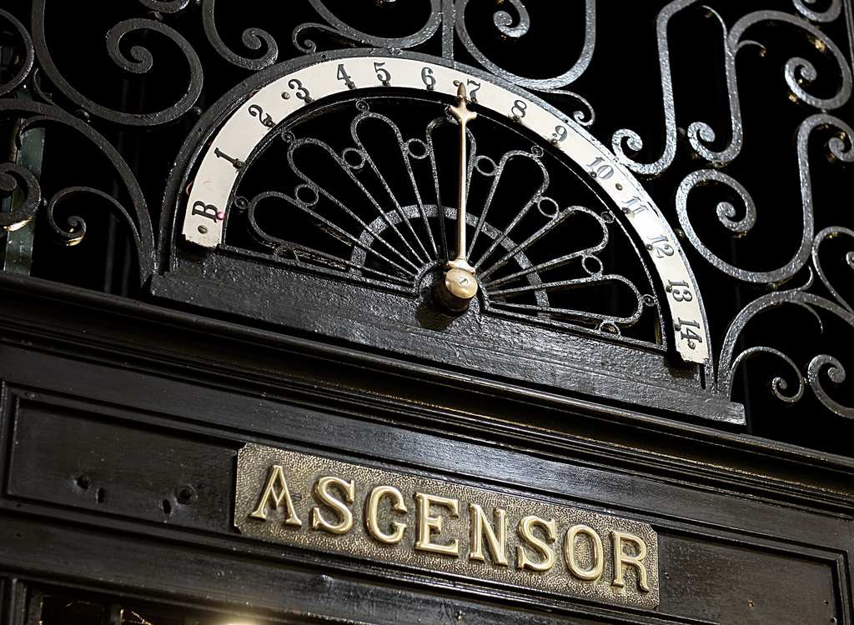
Elevator Pitch!
5 minutes/presentation
This photo by an unknown author is under license CC BY-SA

Slide 12
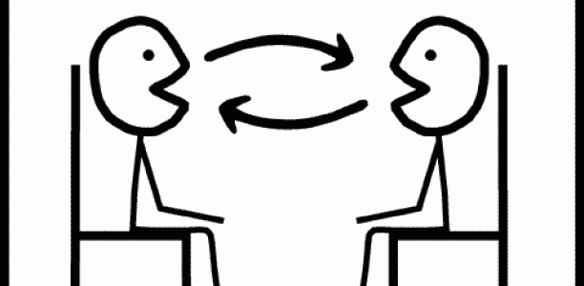





Speed dating!
5 minutes/couple
This image by an unknown author is under license CC BY-SA-NC
ROUND 1:
ROUND 2:
ROUND 3:
ROUND 4:
This photo by an unknown author is under license CC BY-SA

Slide 13

Thank you!

Slide 14
Credits
Special thanks to all the people who made and released these awesome resources for free:
Presentation template by SlidesCarnival
Photographs by Unsplash

